Slide 1
Theme 21 - IT Applications
Guidance Plan:

Slide 2
DISCLAIMER
The information contained in this presentation is merely for educational and informational purposes. It is not intended as a substitute for the judicious Instructional materials from Election Commission of India, its Circulars and Notifications.
While information in this presentation has been verified to the best of our abilities, we cannot guarantee that there are no mistakes or errors. You by yourself assume the sole responsibility of acting upon any information from this presentation, you do so at your own risk.
The readers are advised to read & follow the updated instruction materials available on the website of ECI ( eci.gov.in )

Slide 3
PREFACE
INTRODUCTION
OBSERVER PORTAL AND OBSERVER APP
NATIONAL GRIEVANCES REDRESSAL SYSTEM (NGRS)
NATIONAL GRIEVANCE SERVICE PORTAL (NGSP)
NATIONAL VOTER SERVICE PORTAL
EVM MANAGEMENT SYSTEM (EMS)
ENCORE
VOTER TURNOUT
KNOW YOUR CANDIDATE (KYC)
GARUDA/ BLO APP
OTHER APPS

Slide 4
Introduction
ECI and Information Technology (IT)
Easier delivery of services & access to electors. | On-line application for Electoral Roll Electoral Roll search facility on website, through SMS & Mobile App Polling Station locations on maps on ECI website Call centre with 1950 for public grievances/information/help
Greater Transparency | Displaying affidavits of candidates indicating personal, financial and legal status for public view Electoral Rolls on the website Use of Poll Day Live webcasting from Polling Stations
Better Election Management | Observer Management system Poll monitoring Election Monitoring dashboard for officers at all levels EVM tracking through software Trends and result live dissemination through Portal Know your Candidate

Slide 5
ROLE OF IT IN TRANSFORMING INDIAN ELECTIONS
BACK
ECI has been keeping pace with Technological changes in order to:
Bring improvements in electoral process
Transparency and speedy conduct of elections
Enhance people participation in electoral process
Almost every Election process is being supported by IT
Major IT Interventions introduced are
  Computerization of Electoral rolls
  Issue of unique EPIC to all electors
  Use of Electronic Voting Machines
  Use of IT in Elections planning, conduct and monitoring
  National Grievances Service and Access to Information

Slide 6
GENERAL OBSERVER
General Observers are deployed during elections immediately after announcement of Election for observing:
  The process of scrutiny of Nominations
  Implementations of MCC Violations
  Overseeing the EVM deployment
  Randomization of Election Personnel
  Counting Process

Slide 7
OBSERVER PORTAL AND OBSERVER PORTAL
ECI has developed online portal for database management of General Observer, Police Observer and Expenditure Observer from amongst the Civil Services of Govt. of India
Officials of ECI prepares the deployment schedule through this online portal
The respective Observer gets the notification of their deployment through the Mobile App as well as through this Portal
Upon their deployment, all the reports are submitted to ECI either using the Mobile App or through the portal on URL https://observerseci.eci.nic.in/

Slide 8
OBSERVER PORTAL AND OBSERVER APP
All correspondence from ECI and all the Important Communication between ECI and Observer happen through the Observer Portal only.
The Mobile App reports all the cases of MCC violations reported through the cVigil App allowing the Observer to view the same and if required, comment on their nature of disposal

Slide 9
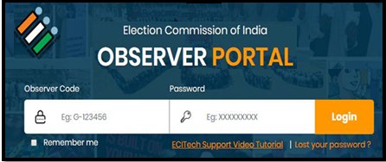
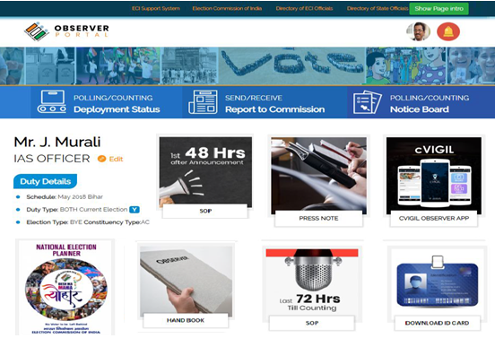

OBSERVER PORTAL
Observer logs into the portal using their credentials and upon entering OTP received on their regd. Mobile
Profile editing is done through the menu

Slide 10
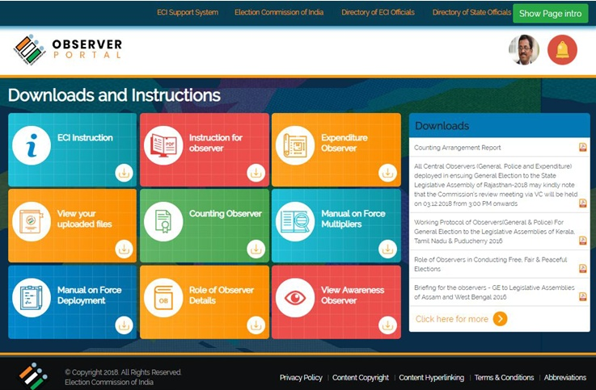
DOWNLOADS & INSTRUCTIONS

Slide 11
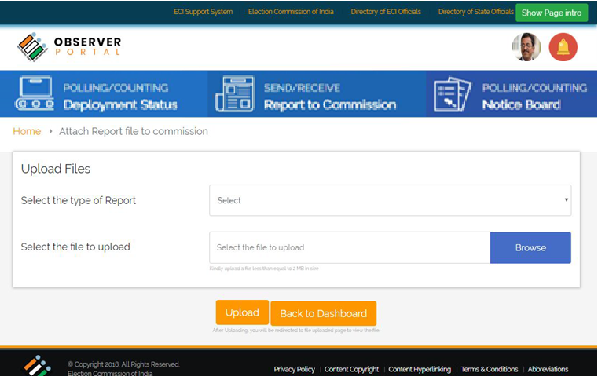
SEND/RECEIVE REPORTS FROM ECI

Slide 12
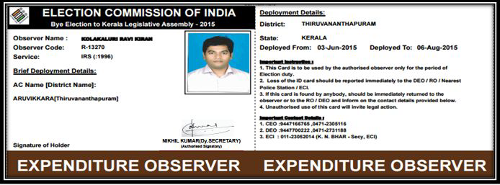
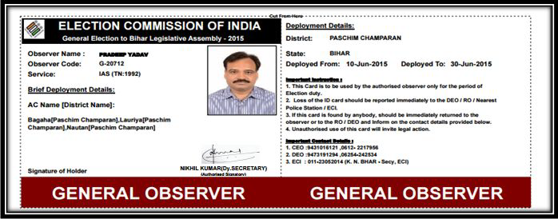
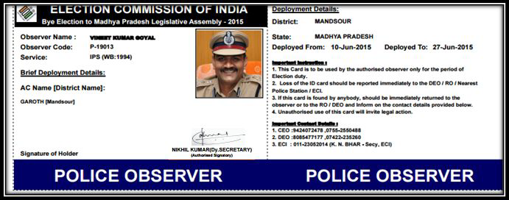
OBSERVER ID CARDS
EXPENDITURE OBSERVER
GENERAL OBSERVER
POLICE OBSERVER

Slide 13
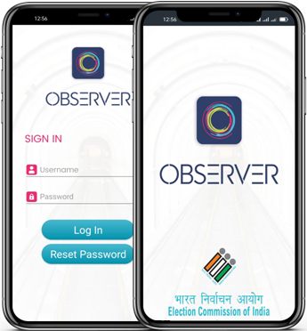
OBSERVER APP - OVERVIEW
BACK
OBSERVER RECEIVE/SEND ON THEIR MOBILE
File their arrival, departure schedules
Their complete deployment schedule
All Notices, Constituency details , etc.
Information of cVIGIL cases
Information of Flying Squad
View profile, Notice Board
Fill reports via options available on the dashboard.

Slide 14
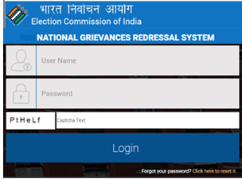
NATIONAL GRIEVANCES REDRESSAL SYSTEM
NGRS is a seamless and Integrated Help Desk / Call Centre / Single Window system.
Facilitates stakeholders like Citizens, Electors, Political parties, Candidates, Media and Election officials at National, State and District and AC level.
Fastest way to lodge grievance by using different channel of NGRS [ Voter Helpline App / Voter Portal / PwD App/National Grievances Service/Contact Centre ]
Can lodge both Election and Non-Election Related Complaints.
Track every complaints lodged by any channel.
Every user have a separate dashboard like Public, CEO, DEO, ERO and ECI officials.

Slide 15
NGRS – MONITORING & FOLLOW UP
GRIEVANCE
ELECTION PERIOD | NON-ELECTION PERIOD
Complaint has redressal time of max Two days | Complaint has redressal time of max One Month
Complaint has to be resolved within this period
If in this period RO, DEO does not taken action Then it go to one upper level officer after redressal period over. Ex: If complaint is of AC level, then it goes to District level.

Slide 16
NGRS – DISPOSAL OF COMPLAINTS
URL: https://eci-citizenservicesforofficers.eci.nic.in
All complaints are received on the Officer Portal Complaint is handled based on its nature and action is taken by concerned officers like ERO, RO, DEO or CEO Every Complaint have different redressal period If within the redressal period RO, DEO does not taken action, then complaint goes to one upper level officer after redressal period over, its status changes to Default. Once in every month. the existing Public Grievances Redressal System takes the reports from NGRS and sends to the respective state

Slide 17
NGRS – COMPLAINT STATUS
BACK
STATUS | DESCRIPTION
OPEN | When first time complaint lodged
IN PROGRESS | Complaints Noted or Forwarded but not disposed
RESOLVED | Complaints disposed by officer
CLOSED | After 7 days of disposal, status of complaint automatically changes to Closed
DEFAULT | No any action taken by any officer within the time period

Slide 18
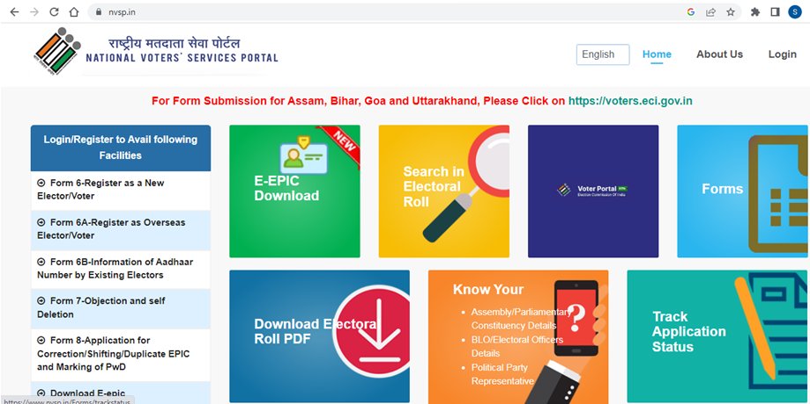
NATIONAL VOTER SERVICE PORTAL (NVSP)

Slide 19
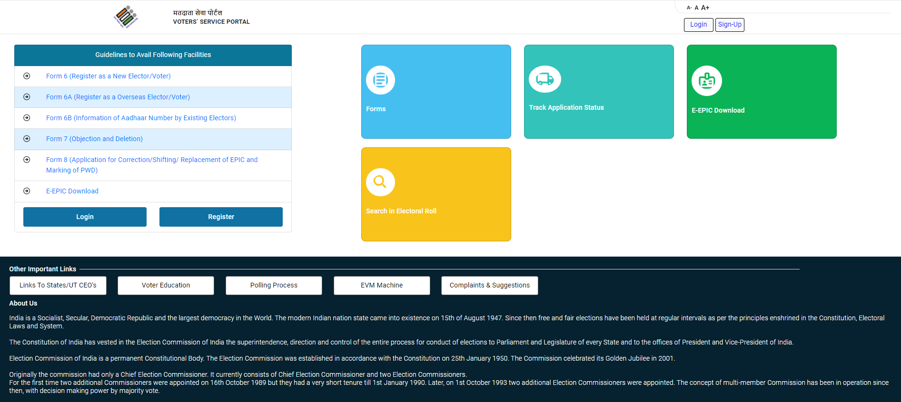
NATIONAL VOTER SERVICE PORTAL (NVSP)
The user friendly interface of this portal provides a single window quality services to citizen towards higher transparency and ease of access of information.
The Electoral Search from over 85 Crore electoral data within a blink of eye is possible due to the use of cloud services & responsive user interface.

Slide 20
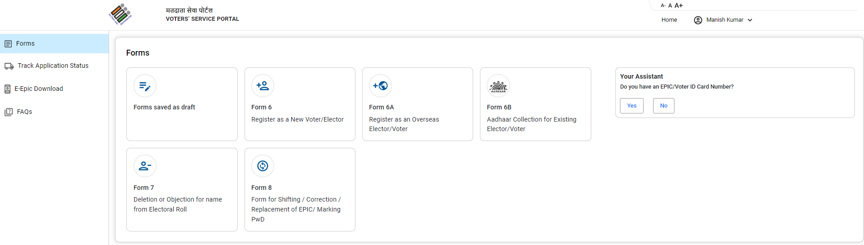
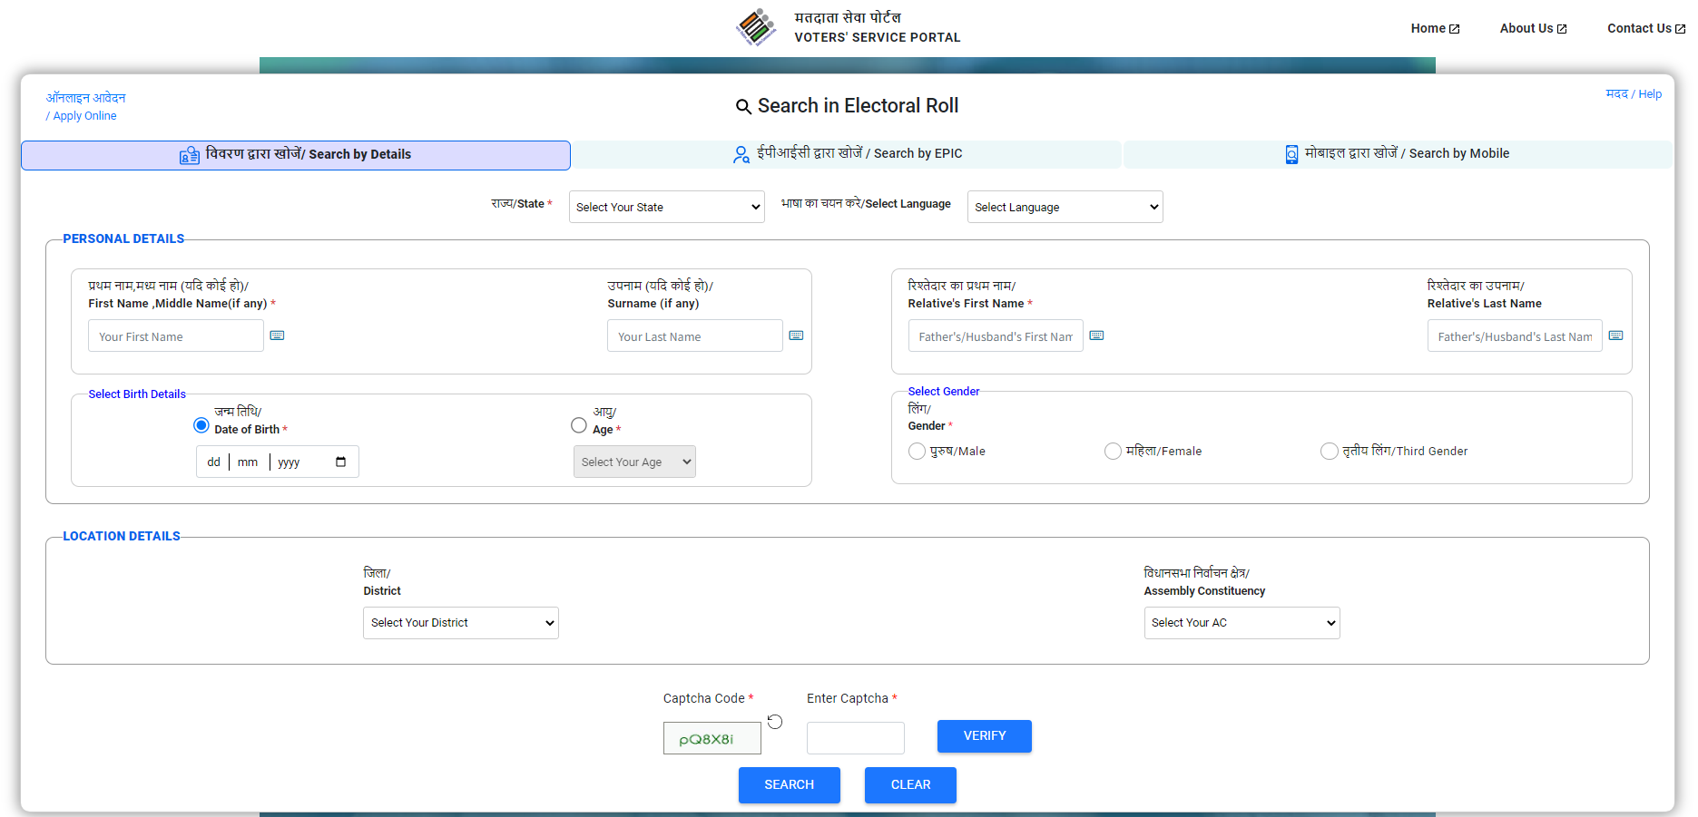
NATIONAL VOTER SERVICE PORTAL (NVSP)
BACK
This interface helps the citizen
  Search their name in electoral roll on Details (Name, Relative Name, Age/DOB, State, AC, Location from Google Maps) / EPIC No.
  Apply online for registration as new voter
  Correction of entries or change of address
  Track status of application
  Print voter information slip
  Find their BLO, ERO and DEO etc.

Slide 21


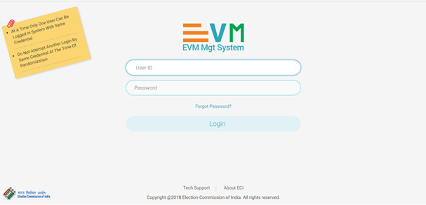
EVM MANAGEMENT SYSTEM
Single integrated application for EVM Life cycle
Movement of EVM from one to another district
Randomization at District and constituency level
Replacement of EVM at various levels

Slide 22
EVM MANAGEMENT SYSTEM
EVM Management System is used to manage inventory of EVM units
This system offers transparency and ensures that there is no manual intervention at any level from the manufacturer to the polling stations
Through EMS, the Commission ensures that thorough Randomization of the EVM first happens at the AC level and other at the Polling Station level.
This core activity of the ECI has brought confidence to voters about the Electronic Voting Machines

Slide 23
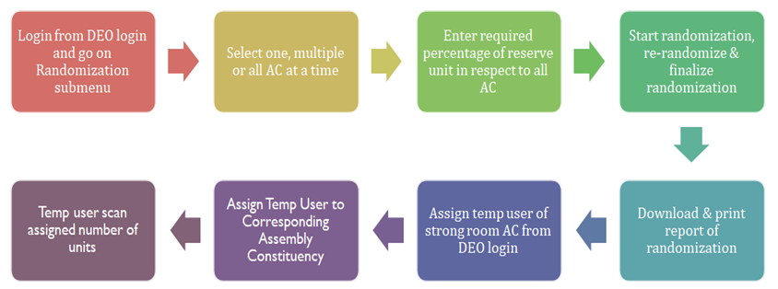
SOP FOR FIRST RANDOMIZATION
Preparatory steps -
FLC Ok unit must be available
Strong room AC must be created
Temp user must be created for strong room AC

Slide 24
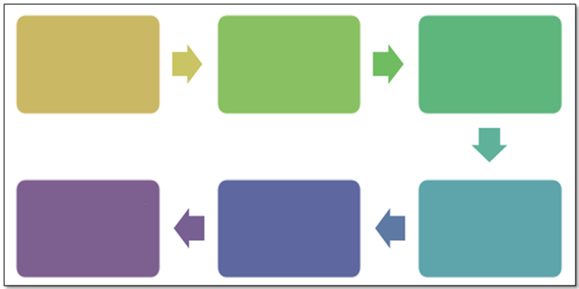
EMS APP
Preparatory steps -
First randomization must be done
All the units must be received in strong room AC
Count of polling station & candidate must be verified
Login from PC User (PC Election) and AC User (AC Election) and go the the Randomization Menu
Select One AC at a time
Verify count of PS and count of Candidates
Start Randomization, Re- Randomization & finalize Randomization
Dispatch all units to Polling Stations
Download and Print report of Randomization

Slide 25
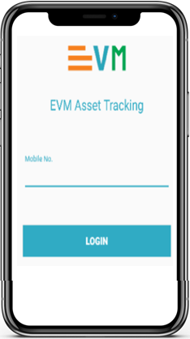
EVM APP
Works as an extended scanner
Sends / receives scanning
Marking of FLC OK or defective
Marking of units for awareness
Only FLC units can be used in election
Receiving of units in respective AC
Receiving back units in normal warehouse after poll

Slide 26
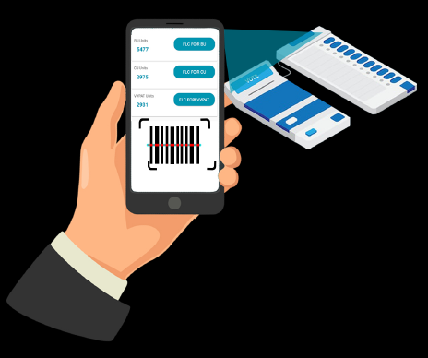
EVM MANAGEMENT SYSTEM
BACK
EMS App is used by temporary user at warehouse level for scanning of barcodes for identifying and tracking BU, CU and VVPAT.

Slide 27
NATIONAL GRIEVANCE SERVICE PORTAL
NGSP is a pan India integrated multilingual contact centre (739 centres) supplied with ICT equipments and trained manpower launched by ECI
Operations of NGSP are monitored by the District Level Officer under supervision of District Election Officer.
These service centres have same set of information regarding Electoral Roll, Voter ID Card, Election Process and other FAQs
Any citizen can approach ECI through these centres by dialing 1950 toll free number.
The call centre agent logs all its calls into NGSP portal, thus providing Tracking number and accountability.

Slide 28
NATIONAL SERVICE PORTAL
BACK
Alternate ways of approaching NGSP are:
  Sending complaint Email to the Portal
  Direct registration of Complaint through Voter Helpline App / NGSP Portal
  Information / Suggestions / Feedback can also be logged through NGSP
Complaint redressal:
  Complaints are addressed by the respective ERO, DEO, CEO or Division of ECI within the stipulated timeframe prescribed by the Commission

Slide 29

ENCORE
ENCORE is an integrated application that can perform :
Pre-poll activities like candidate nomination, scrutiny, permission, etc.
Poll day activities like voter turnout
Post poll activities like counting, Index Card, Expenditure Monitoring
ENCORE

Slide 30
ENCORE TREE
Candidate Nomination
Digitization of nomination form to create database of candidate that used in various election process
Candidate Scrutiny
Process of marking nomination as Accepted / Rejected / Withdrawn and finalisation of contesting candidate.
Affidavit Portal
This allows citizens to view the complete list of Candidate Nominations who have applied for the elections and their affidavits
Election Permission
Permission module allows the candidates, political parties or any representatives of the candidate to apply for the permission.
Election Counting
Application is being used to capture data entry round wise for counting and result dissemination
Voter Turnout
Poll day activity performed by RO’s to provide 2 hourly report of estimated voter turnout in different slots.
Expenditure Monitoring
The Online application of expenditure provides for capturing of expense by candidate over public meetings, posters, banners, vehicle, and ceiling for candidate expenditure.
Index Card
This enables RO’s to fill the Index card online after counting that contains each detail of elections since election declaration to results.

Slide 31
ENCORE : ONLINE NOMINATION
This facility helps the candidates for making online data entry of their personal details in nomination forms and affidavit (Form-26) through ECI Suvidha portal i.e. from “suvidha.eci.gov.in”.
Online scheduling of meeting for document submission.
Online Nomination
Online security deposit facility and generation of e-affidavit.
Data validation & alert to avoid mistakes.

Slide 32
ENCORE : CANDIDATE NOMINATION & SCRUTINY
This facility to RO helps digitize the physically received nomination forms. RO can also perform other Nomination related processes like uploading affidavits, multiple nomination, scrutiny, marking of validity, allotment of symbol and finalization of list.
Apply multiple Nominations
Candidate Nomination & Scrutiny
Digitization of physically received forms.
.
Upload Affidavit and counter affidavit.

Slide 33
ENCORE : PERMISSION MANAGEMENT
Permission module allows the candidates, political parties or any representatives of the candidate to apply online for the permission for meetings, rallies, temporary offices, and others through SUVIDHA Portal.
Assignment of Nodal in Master Data for similar type of permission.
Permission Management
Quick response in case of multiple approving authority..
Easy digitization of physical forms

Slide 34
ENCORE : NODAL APP FOR NODAL OFFICERS
Through this app, the Nodal Officers can approve various permissions assigned to them during the MCC. This app help the nodal officer by making data accessible and efficient to take decision
Easy for quick response of the assigned nodal officer.
Nodal App
for
Nodal Officer
NO can accept / reject with comment and add the NOC if required.
NO can view decision of RO and attached document.

Slide 35
ENCORE : CANDIDATE APP FOR CANDIDATES
This app is designed to provide status of all the applied nomination and permission requests.
Easy for quick response of the assigned nodal officer.
Candidate App
for
Candidate
Candidate can view the status of all the applied nomination and permissions.
Can view and download the attached document of permission.

Slide 36
ENCORE : AFFIDAVIT PORTAL
Using this facility, any citizens can view the details of all accepted, rejected, withdrawn and contesting contestants, including the affidavit provided by the candidate
Displays complete candidate profile
Affidavit
Portal
Contesting candidates list as per FORM 7A
Scrutiny status with affidavit and counter affidavit.

Slide 37
ENCORE : VOTER TURNOUT
This simple and time-bound mechanism provides real-time dissemination of Voter Turnout trends to Election officers and Citizens directly through ECI Voter Turnout App. The turnout is auto-compiled as and when the Returning Officers enter the data.
Easy way to display the two hourly voter turnout in public domain.
Voter
Turnout
Data available with multiple filters.
Detailed turnout entry of Votes in PS wise entry in end of poll.

Slide 38
ENCORE : RESULT WEBSITE
This facility helps the citizen to view the disseminated result of the counting day. The timely publication of the round-wise information is vital for establishing a single source of authentic data.
Detailed data of votes like EVM votes, postal votes, total votes and percentage of votes
Result Website
Single Source of authenticated data
Graphical representation of the trends with filters of party wise & constituency wise data.

Slide 39
ENCORE : INDEX CARD MODULE
This facility helps the Returning Officer to fill the Index card online after counting. It contains each and every detail of elections from the schedule of elections to the declaration of results.
Detailed report of voter turnout in each assembly.
Index Card Module
Data available in multiple report format.
Correction facility available similar to physical index card.

Slide 40
ENCORE : COUNTING MODULE
BACK
The ENCORE counting application is an end-to-end application for returning officers to digitize the votes polled, tabulate the
round-wise data and then take out various statutory reports of counting.
Table wise entry of EVM Votes.
Counting
Module
Round wise result dissemination to public portals
Multiple user to make table wise entry with separate PB entry.

Slide 41

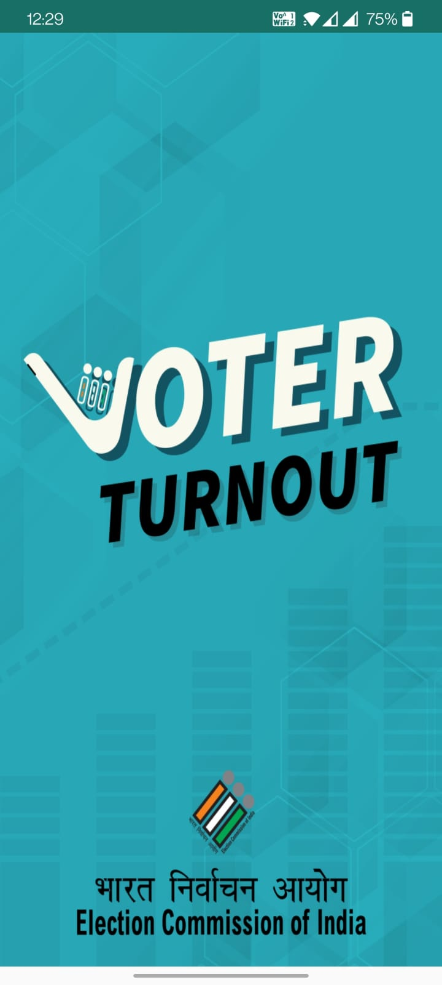
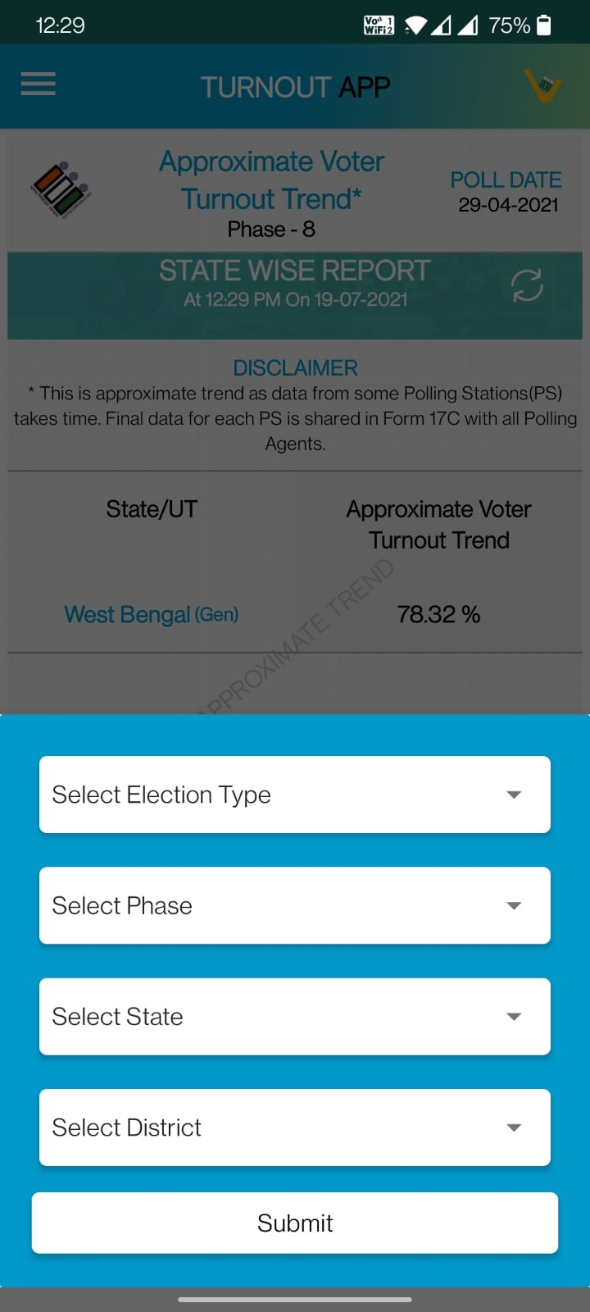
VOTER TURNOUT APP
This simple and time-bound mechanism provides real-time dissemination of Voter Turnout trends to Election officers and Citizens directly through ECI Voter Turnout App. The turnout is auto-compiled as and when the Returning Officers enter the data.
Features:
Two hourly estimated voter turnout
PS wise Voter turnout
Voter Turnout App
End of Poll Turnout
(male, female & other)

Slide 42
VOTER TURNOUT : DATA ENTRY CYCLE
Slot gets open for half an hour as per allotted time. Returning officer needs to login ENCORE
At dashboard update the estimated voter turnout in two different boxes with surety to provide same entry.
Update the same turnout percentage as final confirmation in the pop-up and update.
Slots get close as per the allotted time and provided estimated percentage get disseminated on voter turnout app for citizens.

Slide 43
VOTER TURNOUT : DATA ENTRY CYCLE
End of Poll
Returning officer needs to fill all the detailed data of voter turnout by the end of P + 1 Day. After that update will not be allowed.
Poll
Start
09:00 AM - 09:30 AM
Returning officer can start updation of estimated turnout from 09:00 AM. RO can update data as many time as he wish till 09:30 AM. Slot get closed and data gets published automatically at 09:30 AM as the final data.
7
1
Poll Day Activity
Close of Poll
RO can fill the close of poll data from 07:00 PM to 12:00 AM on poll day. Updation for close of poll will end in mid night on poll day.
6
2
11:00 AM - 11:30 AM
All the process remain same as
09:00 AM to 09:30 AM slot.
05:00 PM - 05:30 PM
All the process remain same as
03:00 PM to 03:30 PM slot.
5
3
01:00 PM - 01:30 PM
All the process remain same as
11:00 AM to 11:30 AM slot.
4
03:00 PM - 03:30 PM
All the process remain same as
01:00 PM to 01:30 PM slot.

Slide 44




VOTER TURNOUT : POLL DAY ACTIVITY PROCESS FLOW
09:00 AM
ENCORE
09:30 AM
CEO
CEO will enable update button for RO to update missed round
11:00 AM
11:30 AM
Voter Turnout Dashboard
Missed
01:00 PM
01:30 PM
Data Entry Start
DataBox 1
Data Box 2
Data Automatically gets Published on Voter Turnout App
On Time
03:00 PM
03:30 PM
Returning
Officer
Press Update Button
05:30 PM
05:00 PM
Fill Data in
POP - UP
12:00 AM
(Close of Poll)
07:00 PM
(Close of Poll)
Press Update Button
Turnout Entry
End Timings
Turnout Entry
Start Timings

Slide 45



VOTER TURNOUT : END OF POLL PROCESS FLOW
CEO
DEO Responsibilities
ENCORE
DEO Login
Verify All PS wise Data
Data
Correct
Finalize the Data
ENCORE CEO Login
Verify Data
Data
Correct
DEO
Finalize
PS Data
Enter
PS wise Data
Data Mismatch
Send to RO for Update
Data Mismatch
Send to RO for Update
Publish Voter Turnout
Start
CEO Responsibilities
ENCORE
RO Login
Returning
Officer
End of Poll Process Flow
RO Responsibilities

Slide 46
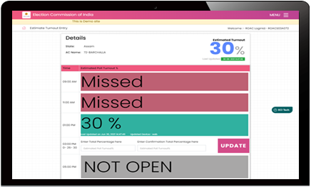
VOTER TURNOUT : DASHBOARD
RO can make entry for Estimated voter turnout of different timing during 30 minutes.
If RO missed the entry of any time slot then ‘Missed’ status will be shown for that particular slot.
Other time slot will be shown as Not Open if time has not reached of that particular slot.

Slide 47
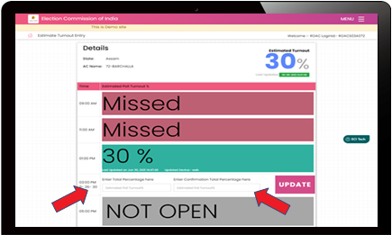
VOTER TURNOUT : WHERE TO ENTER THE DATA
RO enter the value of estimated voter turnout in both textbox and click on Update button

Slide 48
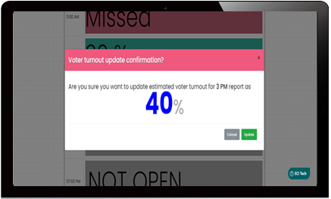
VOTER TURNOUT : MULTIPLE CONFIRMATION
BACK
A confirmation pop up will shown the entered percentage value. Returning officer need to confirm the same before end of time slot

Slide 49


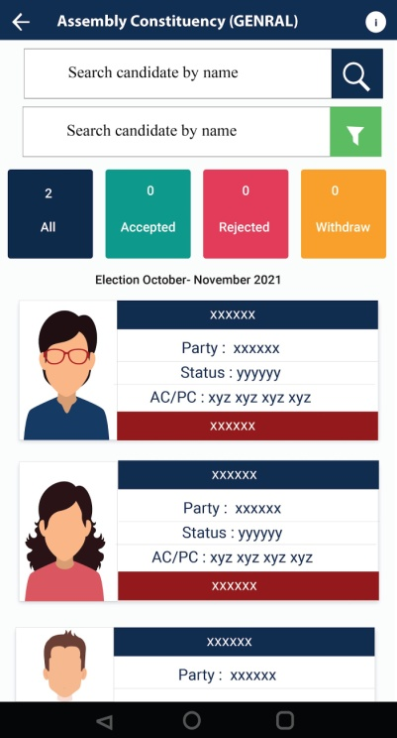
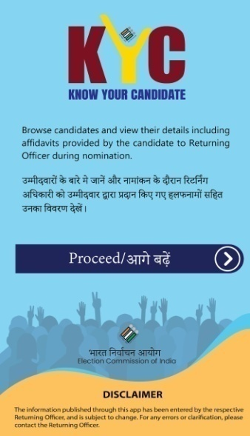
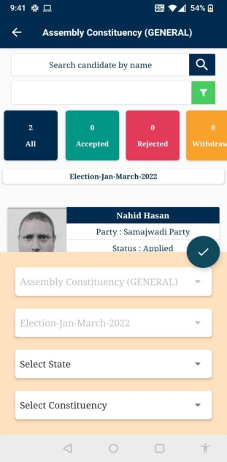
KNOW YOUR CANDIDATE (KYC)

Slide 50

CRIMINAL ANTECEDANTS
Hon’ble Supreme Court in its judgment dated 10.08.2021, in contempt petition(C) No. 656 of 2020 in contempt petition (C) no. 2192 of 2018 in writ petition (civil) no. 536 of 2011, under para 73(ii) has directed as under:-
  “The ECI is to create a dedicated mobile application containing information published by candidates regarding their criminal antecedents, so that at one stroke, each voter gets such information on his/her mobile phone;”
  In the same concern the KYC App is designed in android & iOS both to share the criminal antecedent information of the candidate.

Slide 51
KYC : RESPONSIBILITIES OF RO
RO needs to select the checkbox “Yes” or “No’” for Candidate Criminal Antecedent and upload the scanned document submitted by candidate
RO must ensure that the right document is uploaded for the candidate’s criminal antecedents as the same gets public visibility through dedicated KYC (Know Your Candidate) App as and when it is uploaded.
RO needs to re-verify & ensure that checkbox is marked appropriately as “Yes” or “No” as per the details submitted by the candidate

Slide 52
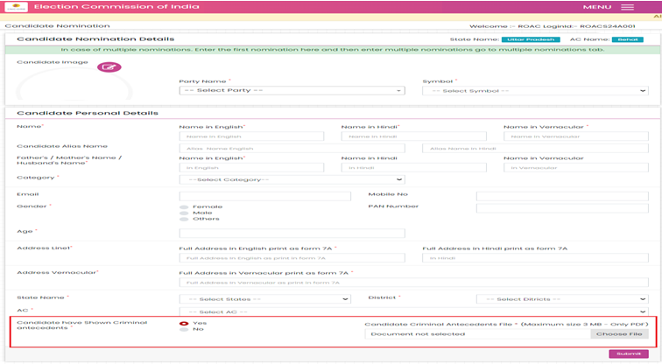
KYC : RESPONSIBILITIES OF RO
Criminal Antecedent
Upload Document

Slide 53



KYC : RESPONSIBILITIES OF DEO / CEO
“CEO/DEO needs to ensure that all Returning Officers follows the instructions carefully for all the candidates without exception”
Android
Available In
iOS

Slide 54


KYC : RESPONSIBILITIES OF DEO / CEO
BACK
“Lightweight user friendly Mobile App (Android and iOS) to show information published by candidates during nomination regarding their criminal antecedents”
Browse all candidates who filled nomination
Search Candidate by Name & View Candidate Details
View candidate’s affidavit including criminal antecedents

Slide 55
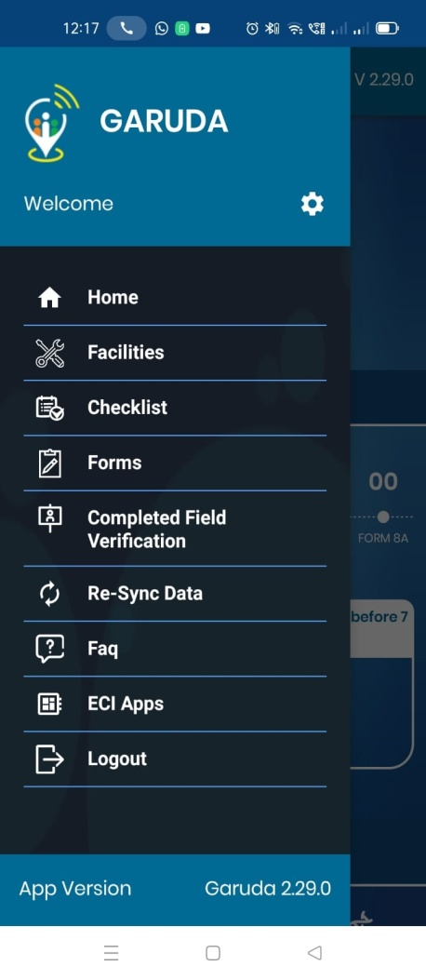
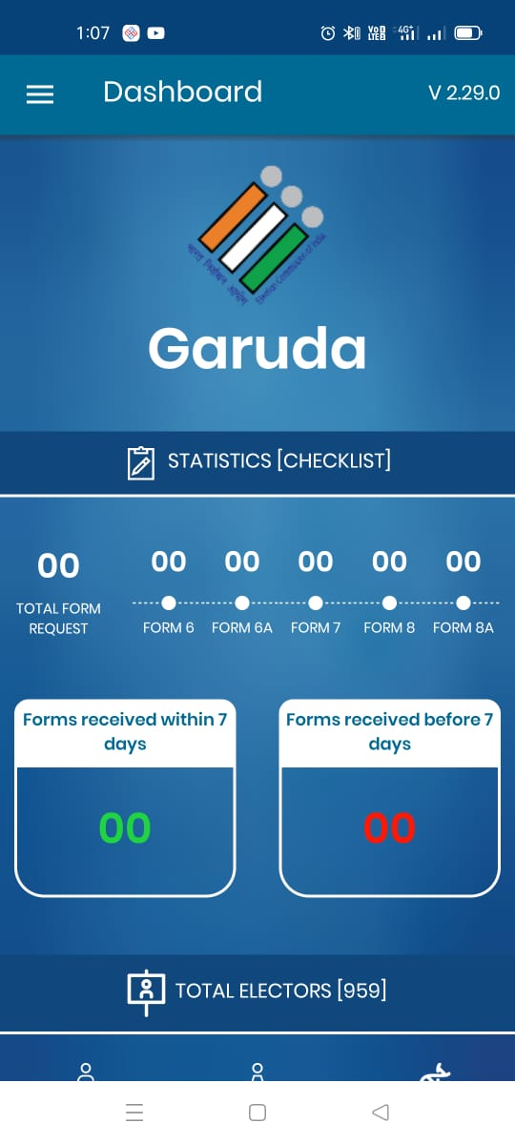
GARUDA APP - OVERVIEW
G - GEOGRAPHICAL
A - ASSET
R - RECONNAISSANCE
U - UNIFIED
D - DIGITAL
A - APP

Slide 56
GARUDA APP: OVERVIEW
This is a dedicated App developed by ECI is for Booth Level Officers & offers all BLO related services and is available on Google Play store.
This App helps AMF / EMF, GIS location, images, etc. directly from BLO’s.
The key features of this App are Field verification and Form submission
All the features of the erstwhile BLONET App have been integrated with revamped design and user friendly interface
This is a secured, simple and easy to use App
The BLO APP is the new version of this App is already rolled in state of Goa

Slide 57
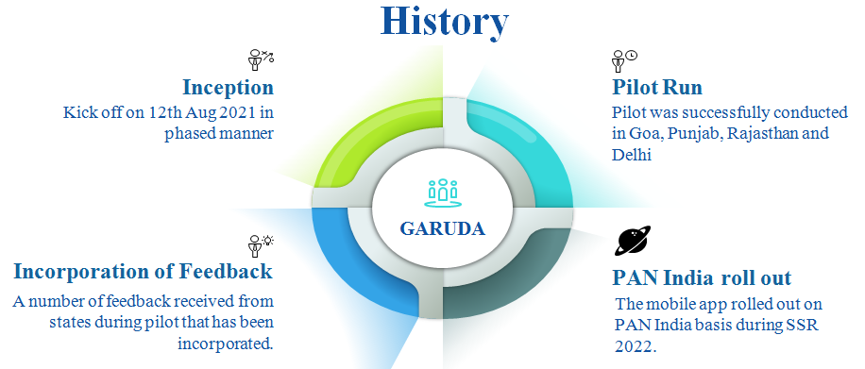
GARUDA APP : HISTORY

Slide 58

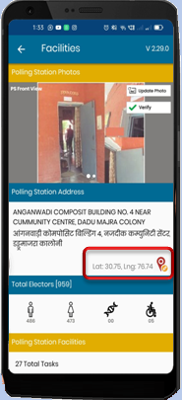
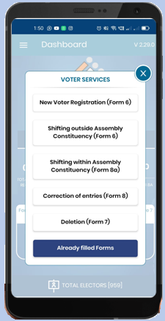
GARUDA APP FEATURES
Checklist & Field Verification
    Status of forms received pending for action
    Total number of forms received pending for action
    Status of forms received within & before 7 days
    Capture GIS Coordinates of Polling Station
    Submit forms on behalf of Elector (Online / Offline)

Slide 59
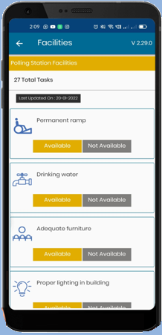
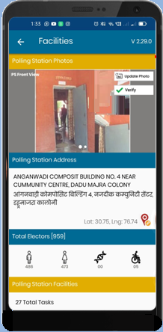
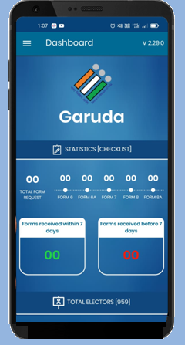
GARUDA APP FEATURES
    Collects Feedback on AMF & EMF (Assured/Essential)
    Add/Update & 2 Photos of Polling Station
    Auto Assignment of Form 6 for Field Verification
      Form filled by BLO for their polling station will get instantly assign them for field verification in their checklist.”

Slide 60
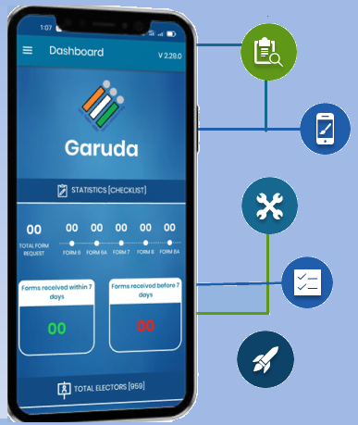
GARUDA APP : BENEFITS
Quick voter registration
Hassle free field verification of electors
Quick search and view of electors details of own polling station in both online and offline mode.
Go green initiative: Save Paper, Go Electronic!
Elector analytics for BLOs on the fingertips
Over 1 Crore forms received from all States & UT’s in Voter Helpline app since Oct 2022

Slide 61
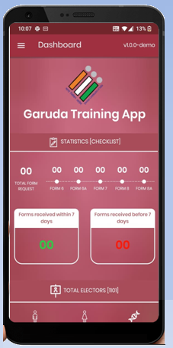
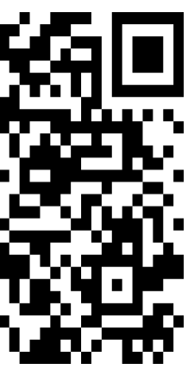
GARUDA TRAINING APP : INSTALLATION
Scan the QR code to download demo application
01
02
Install the downloaded Apk
03
After Successful installation, click on open button

Slide 62
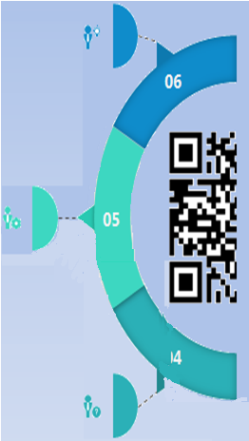
GARUDA TRAINING APP : INSTALLATION
Ready to Login
This will open Login Screen
Provide all requested permissions

Slide 63

GARUDA APP : LOGIN
Enter “training” as password
Select the State
1
5
8
1
7
OTP “123456” will be prefilled
Select the AC
2
6
2
Garuda
Training App
6
Enter part number
3
7
Click SUBMIT button
3
5
Enter mobile number
4
4
8
Ready to use

Slide 64

GARUDA TRAINING APP
BACK
Training App will work in complete offline mode, no internet is required. Proposition
Auto assignment of all forms (Form 6, 7, 8 & 8A)
Available in English & Hindi language

Slide 65
OTHER PORTALS/APPS
BACK
ERONET
Service Voter Portal
Affidavit Portal
SAKSHAM App
C-Vigil App
Voter Helpline App
Booth App
Voter Portal
Observer Management Portal
Election Trends TV
Webcasting and CCTV in Polling Station
Summary

Slide 66

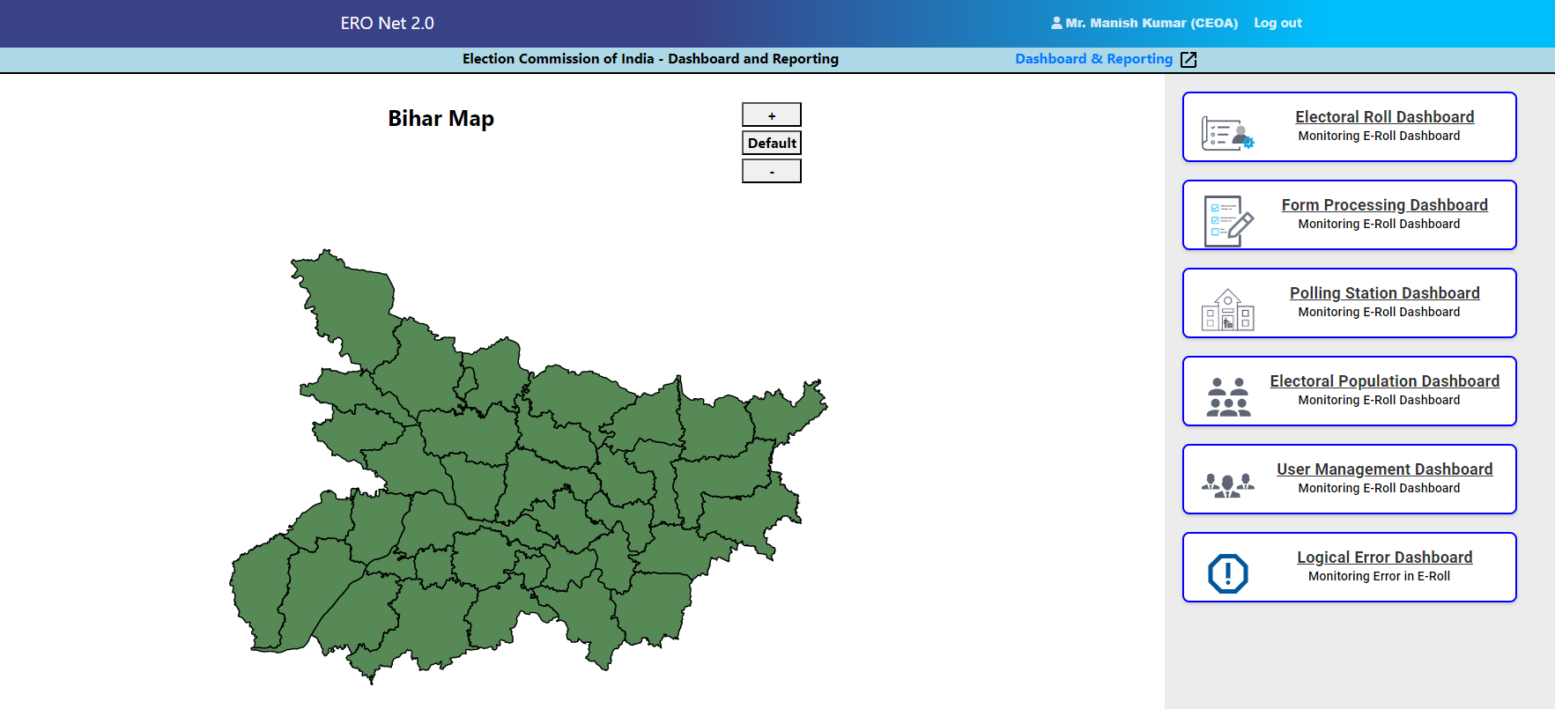
ERONET
ERONET provides right amount of electoral information to the right set of people in the right time, for effective management and timely voter services.

Slide 67
ERONET Key Features:
Auto Serialisation
Infographic Dashboard
1
5
8
1
7
Control Table Management
Alerts, Flags, Auto-Generated messages,& Notification
2
6
2
ERONET
6
Customised Filter
3
7
Easy way of roll Updation
3
5
Use of New Technology
4
4
8
Rationalisation

Slide 68
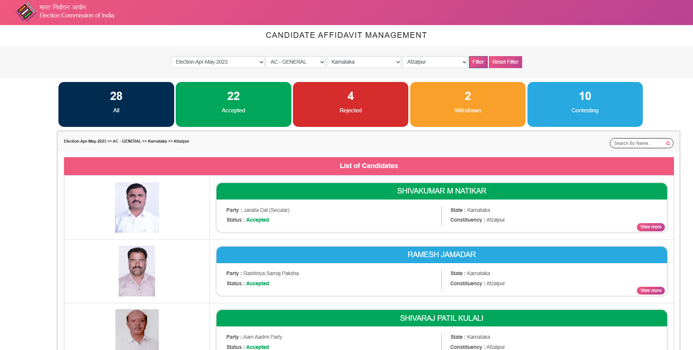
AFFIDAVIT PORTAL
AFFIDAVIT Portal-A public portal to view details of nominated candidates as well as the affidavit of candidates uploaded on ENCORE.

Slide 69
Service voter registration portal (http://servicevoter.nic.in)
Functionalities
Processing of electoral forms
Maintains up to date record of Service voters
Simultaneous addition and deletion process
Single source of online forms acceptance, provides real time monitoring of form processing
Communication between EROs across ACs and States and Record/Unit Offices
Easy to use Dashboard for all users
The purpose of the online Service Voter Registration Portal system is to provide convenience and easy-to-use portal for Defence Personnel, employed under the Government of India and member of an Armed Police Force of a State and serving outside that state. The system allows registration and acceptance of forms for Service Voter. Through this online system, District Election Officer assigns the Assembly Constituency to Service Voter, then the form processed by Electoral Registration Officer.

Slide 70

SAKSHAM APP
Customized to provide electoral service facility for the people with disability at their doorstep.
Available in multiple regional languages.
Features of the App
  Marking as PwD
  New registration
  Migration
  Correction/Deletion requests
  Wheelchair request, etc
It utilises the Accessibility features of mobile phones for voters with Visual impairement and Hearing disabilities.

Slide 71
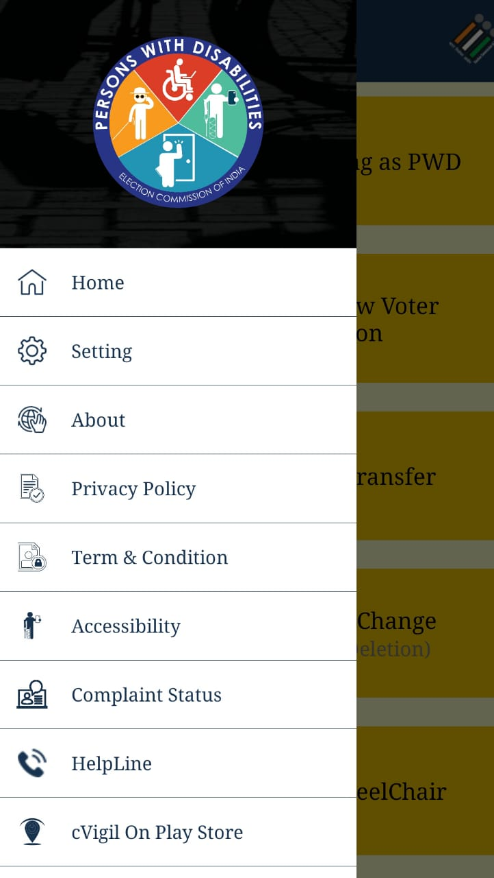
SAKSHAM APP – KEY FEATURES
BACK
Electoral Search
Know Your Polling Station
Register complaints
Search Polling Officials
Booth Locator
Track status

Slide 72
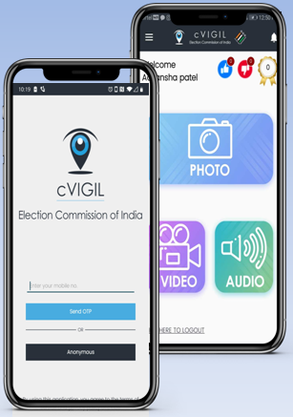
C-Vigil APP – Citizen Vigil App
C-VIGIL provide time-stamped evidentiary proof of Model Code of Conduct / Expenditure Violation by empowering every citizen to click a photo, audio or video using their Smart phones.
Features
  Pictorial, audio and video evidence
  GIS based auto tracking
  Robust and prompt response system
  Get response about the action taken
  Rapid and accurate reporting
  Report live MCC violation
  Doesn’t allow pre-recorded images and videos

Slide 73

C-Vigil APP – Citizen Vigil App
BACK
5 Mins.
15 Mins.
30 Mins.
50 Mins.
Complaint is assigned to Field Unit for Verification
Field Unit arrives on the Venue
Field Unit to Execute the action and submit report
Time taken by RO to inform the Status

Slide 74
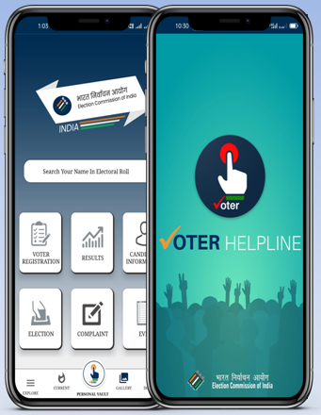
Voter Helpline APP
BACK
Voter Helpline is an umbrella app for all voter related services.
  Voter registration
  Complaints
  Election Results
  Candidate Information
  Electoral Search
  Information on EVM and Election

Slide 75
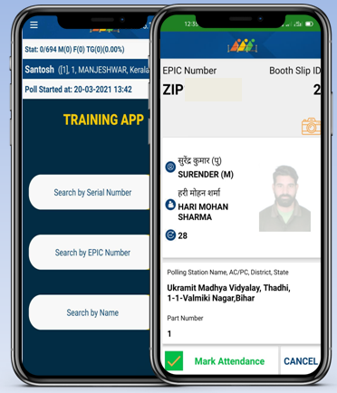
Booth App
BACK
This application helps the Polling Officer to identify the elector with the help of serial number, name or EPIC number.
This also captures the live voter turnout data from the polling station.

Slide 76
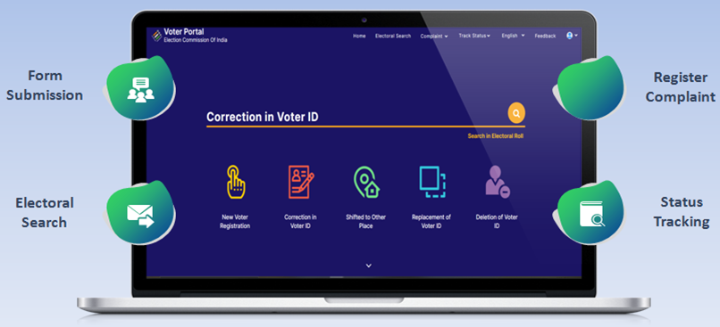
Voter Portal
BACK
Interactive user friendly interface to apply New Voter registration, alteration in entries, deletion, change of address, overseas, replacement of EPIC (Form-001)

Slide 77
Observer Management Portal
BACK
ECI Officials of the state use this portal to monitor and send messages to the deployed observers
Various reports uploaded and filled in digitized format are accessed by ECI through this portal
Salient Features –
  View Filled Reports, Uploaded and Poll Day Reports by Observers
  Send messages/SMS to Observers
  Review Filled Reports
  View the Filled Reports, Uploaded files of Past elections.
  View State wise finalised lists
  Candidate Details - Form 7A

Slide 78
Election Trends TV
BACK
Auto scroll, no manual intervention required.
Display result automatically in public places using large TV Panels.
Graphically-rich micro-details of trends & results are published in real-time.
Display round wise results.
Customized and configured as per requirement.

Slide 79
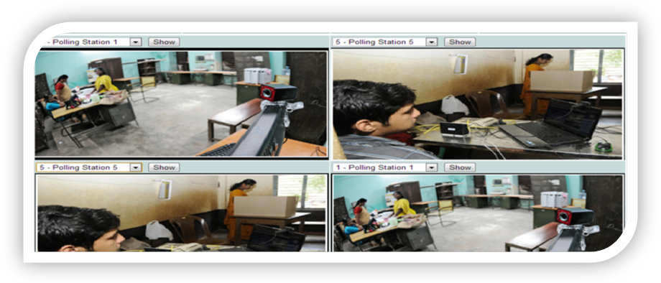
Webcasting and CCTV in Polling Station

Slide 80
Webcasting and CCTV in Polling Station
BACK
Frame work for web casting of video picked up from within the polling booth has been created using open source software tools.
It keeps a check on unwanted activities and help bringing about complete transparency in the voting process.
It also helps a live broadcast and is useful for AWARENESS to the users.
Advantages:
    To keep a check on illegal activities such as booth capturing, money distribution and bogus voting to bringing about complete transparency.
    To broadcast and monitor LIVE election process from a distant polling station.
    To capture faces of voters coming to vote at PS in a sequence for remote viewing by election officials.
    To spread AWARENESS to participate in Free and Fair Elections.

Slide 81
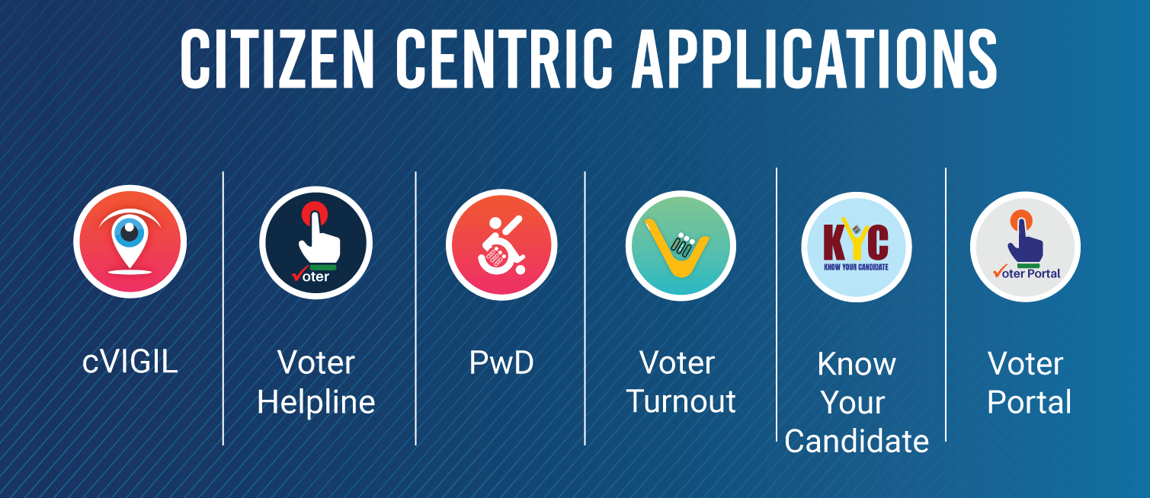
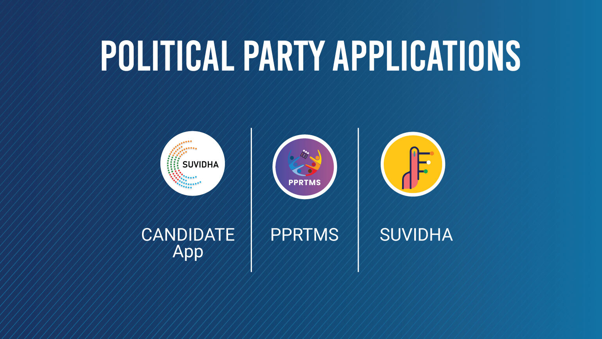
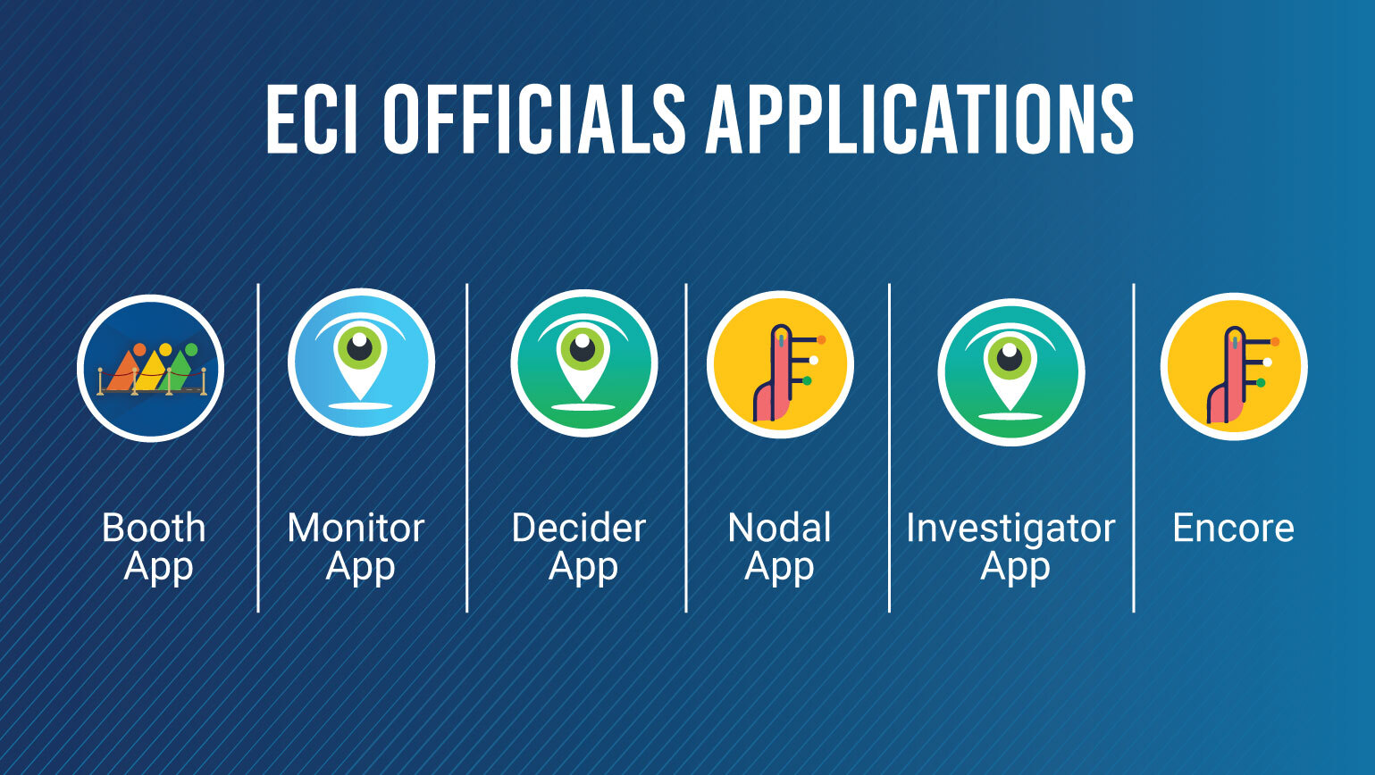
SUMMARY
BACK

